Slide 1

Car Diagnostic Mobile App: Requirement Analysis
This is a comprehensive analysis of requirements for a mobile application designed to help car owners diagnose vehicle issues using artificial intelligence. This presentation examines the completeness, clarity, technical feasibility, and dependency relationships of the gathered requirements.
Our group has conducted a thorough review of the initial requirements, identified inconsistencies and ambiguities, prioritized features based on importance and feasibility, and classified requirements into functional and non-functional categories.

Slide 2





Requirement Completeness Analysis
Comprehensive Stakeholder Input
Requirements gathered from multiple stakeholders including car owners, drivers, mechanics, and lecturers using surveys, interviews, brainstorming, and reverse engineering.
Functional & Non-Functional Coverage
Both functional requirements (app features) and non-functional requirements (usability, performance) are well-documented.
Data Requirements
Data requirements and cleaning processes are addressed, which is crucial for the AI-driven aspects of the application.
Areas for Improvement
More detailed specifications needed for certain requirements, such as an exhaustive list of car faults to be diagnosed.

Slide 3

Clarity & Technical Feasibility
Clarity Assessment
Technical Feasibility
Most requirements are clearly stated and easy to understand, especially those gathered through surveys and presented with visual aids.
The requirements demonstrate good consideration of technical feasibility, acknowledging the use of OBD-II ports, AI-driven diagnostics, and mobile app development.
Direct quotes from interviews enhance clarity, though some requirements could be more specific. For example, "The app should generate revenue" lacks details on implementation methods.
Technologies like CNNs and LSTM for image and audio analysis show awareness of current technical capabilities, though deeper analysis of AI diagnostic accuracy within mobile constraints would strengthen this assessment.

Slide 4

Identified Inconsistencies & Ambiguities
Inconsistencies
Ambiguities
Conflicting survey results about ignoring warning lights (65% vs 51.3%)
Vague "Major feedback" sections with undefined criteria
Unclear app feature prioritization categories
Unclear relationship between "Data Cleaning" and "User Reluctance Assessment"
Limited details on observation methodology and manual review process
Inconsistent sample population descriptions
Missing Information
Exact wording of survey and interview questions
Details about brainstorming session structure
Data storage, management, and security considerations
Ethical considerations related to data collection

Slide 5






Requirement Prioritization
We've prioritized requirements based on importance to users and technical feasibility of implementation.
High Priority
Core features with high importance and medium/high feasibility
Medium Priority
Valuable features with medium importance or lower feasibility
Low Priority
Features with low importance or very low feasibility
High priority features include dashboard light scanning, engine sound analysis, warning symbol explanations, and OBD-II diagnostics. Medium priority features include maintenance history tracking and revenue generation. Low priority features include multilingual support.

Slide 6
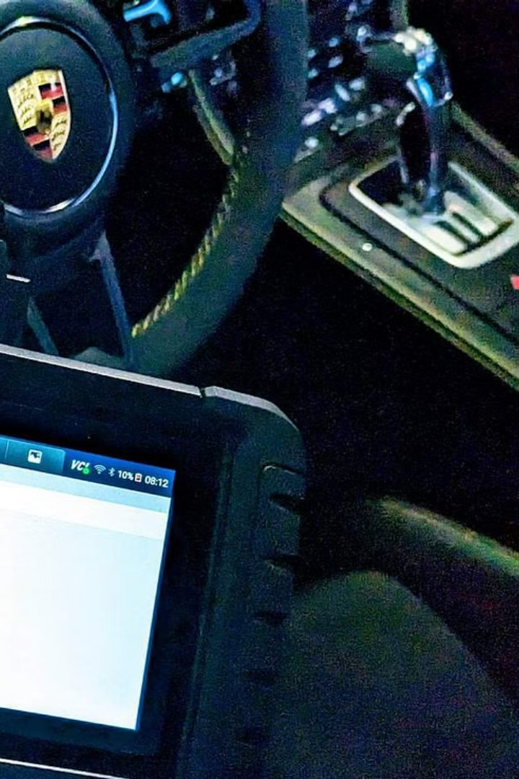
High Priority Requirements
85%
5s
Recognition Accuracy
Processing Time
Minimum target for dashboard and audio recognition in standard test environments
Maximum time to process images and audio for fault diagnosis
3
Core Features
Dashboard scanning, sound analysis, and diagnostic reporting form the essential functionality
These high-priority requirements directly address the core problem statement of helping car owners diagnose vehicle issues. They combine high importance with reasonable technical feasibility, making them the foundation of the application's value proposition.

Slide 7





Functional Requirements
Dashboard Light Detection
Capture dashboard images, recognize multiple warning lights, identify meanings and urgency levels
Engine Sound Analysis
Record and analyze engine sounds for abnormal patterns using trained ML models
Fault Diagnosis
Display possible causes, urgency levels, repair actions, and maintenance tips
Multimedia Support
Provide embedded video links from verified car experts based on identified issues
Offline Functionality
Support basic diagnostics using preloaded data when offline

Slide 8










Non-Functional Requirements
Performance
Usability
Process images and audio within 5 seconds
Intuitive UI requiring minimal technical knowledge
Accuracy
85% minimum recognition accuracy
Portability
Support for Android and iOS platforms
Security
Local encryption and HTTPS communication
These non-functional requirements define the quality attributes and constraints of the system, ensuring it meets user expectations for ease of use, speed, accuracy, and security across different mobile platforms.

Slide 9




Software Requirements Specification
Introduction
Purpose, scope, definitions, audience, and overview
Overall Description
Product perspective, functions, user classes, operating environment, constraints
Functional Requirements
Detailed specifications for all system features and capabilities
Non-Functional Requirements
Performance, security, usability, and other quality attributes
The Software Requirements Specification (SRS) formalizes all requirements into a comprehensive document that serves as a blueprint for development. It includes appendices with information on datasets (audio and image collections for model training), tools and libraries (TensorFlow Lite, OpenCV, Librosa), and a glossary of technical terms.

Slide 10
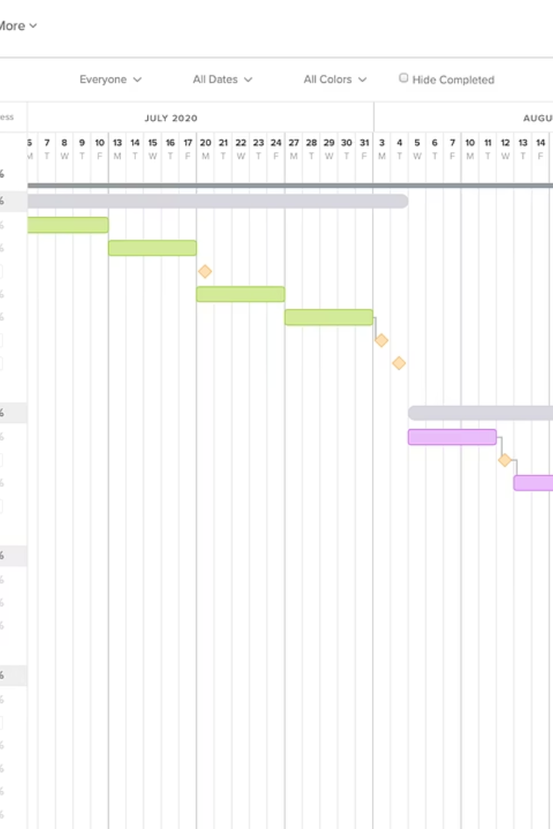




Conclusion & Next Steps
Requirements Validated
Stakeholder verification confirms alignment with user needs
Begin Development
Start with high-priority features using validated requirements
Iterative Testing
Continuous validation with stakeholders throughout development
Launch & Improve
Release MVP and incorporate user feedback for enhancements
Our comprehensive requirements analysis provides a solid foundation for developing a mobile application that helps car owners diagnose vehicle issues using AI. By addressing the identified inconsistencies and ambiguities, prioritizing features appropriately, and classifying requirements into functional and non-functional categories, we've created a clear roadmap for successful implementation.

